Slide 1
Parallel Rendering
Ed Angel
Professor of Computer Science, Electrical and Computer Engineering, and Media Arts
Director, Arts Technology Center
University of New Mexico
Angel: Interactive Computer Graphics 5E © Addison-Wesley 2009

Slide 2
Introduction
In many situations, a standard rendering pipeline might not be sufficient
  Need higher resolution display
  More primitives than one pipeline can handle
Want to use commodity components to build a system that can render in parallel
Use standard network to connect
Angel: Interactive Computer Graphics 5E © Addison-Wesley 2009

Slide 3
Power Walls
Where do we display large data sets?
  CRTs have low resolution (1 Mpixel)
  LCD panels improving but still expensive
  Need resolution comparable to data set to see detail
    CT/MRI/MEG
    Ocean data
Solution?
  Multiple projectors
    Commodity
    High-end
    See IEECE CG & A (July)
Angel: Interactive Computer Graphics 5E © Addison-Wesley 2009

Slide 4
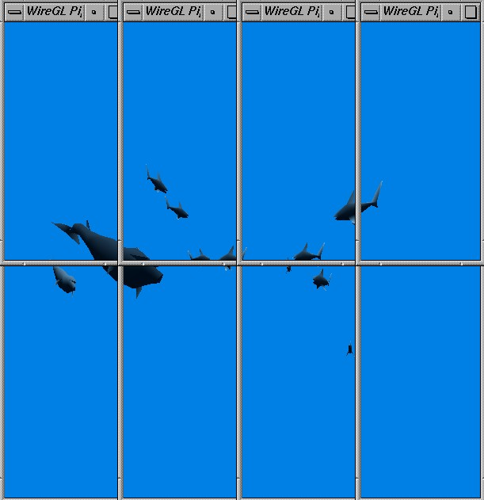
Tiled Display
Angel: Interactive Computer Graphics 5E © Addison-Wesley 2009

Slide 5
CS Power Wall
6 dual processor Intellestations
G Force 3 Graphics cards
6 commodity projectors (1024 x 768)
Gigabit ethernet
Back projected screen
Shared facility with scalable system group
  Investigate OS and network issues
Angel: Interactive Computer Graphics 5E © Addison-Wesley 2009

Slide 6
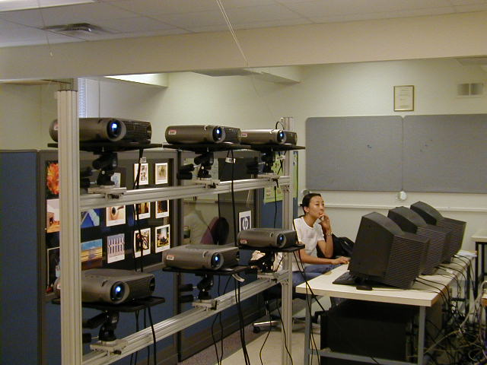
CS Power Wall
Angel: Interactive Computer Graphics 5E © Addison-Wesley 2009

Slide 7
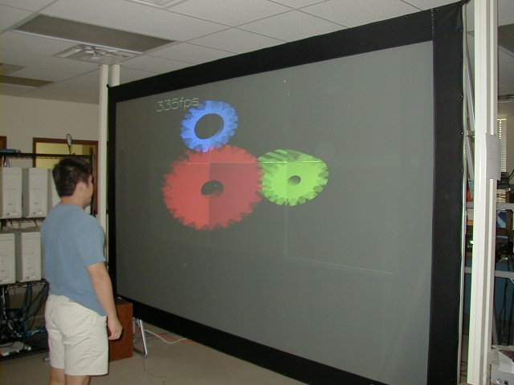
CS Power Wall
Angel: Interactive Computer Graphics 5E © Addison-Wesley 2009

Slide 8
Power Wall
Inexpensive solution but there are some problems
  Color matching
  Vignetting
  Alignment
    Overlap areas
  Synching
  Dark field
Angel: Interactive Computer Graphics 5E © Addison-Wesley 2009

Slide 9
Graphics Architectures
Pipeline Architecture
  SGI Geometry Engine
  Geometry passes through pipeline
  Hardware for
    clipping
    transformations
    texture mapping
Transform
Clip
Project/Sort
Rasterize
Screen
Angel: Interactive Computer Graphics 5E © Addison-Wesley 2009

Slide 10
Building Blocks
Graphics processors consist of geometric blocks and rasterizers
Geometric units: transformations, clipping, lighting
Rasterization: scan conversion, shading
Parallelize by using mutiple blocks
Where to do depth check?
G
G
G
R
R
R
Angel: Interactive Computer Graphics 5E © Addison-Wesley 2009

Slide 11
Sorting Paradigm
We can categorize different ways of interconnecting blocks using a sorting paradigm: each projector is responsible for one area of the screen. Hence, we must sort the primitives and assign them to the proper projector
Algorithms can be categorized by where this sorting occurs
Angel: Interactive Computer Graphics 5E © Addison-Wesley 2009

Slide 12
Three Rendering Methods
Sort
G
G
G
G
G
G
G
G
G
Sort
R
R
R
R
R
R
R
R
R
Composite
Sort-First Rendering
Sort-Middle Rendering
Sort-Last Rendering
Angel: Interactive Computer Graphics 5E © Addison-Wesley 2009

Slide 13
Sort First
Each rasterization unit assigned to an area of the screen
Each geometric unit coupled to its own rasterizer
Must sort primitives first
Can use commodity cards
Sort
G
G
G
R
R
R
Angel: Interactive Computer Graphics 5E © Addison-Wesley 2009

Slide 14

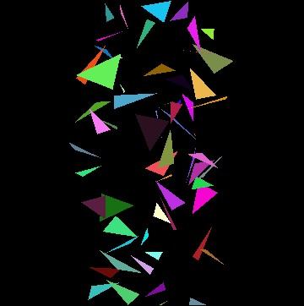

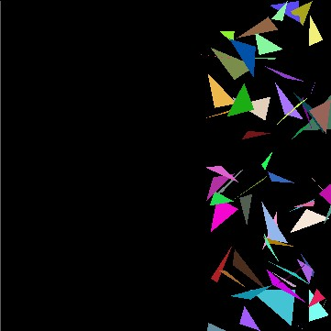
Sort-First Rendering for a Random
Triangles Application
Angel: Interactive Computer Graphics 5E © Addison-Wesley 2009

Slide 15
Sort Middle
Geometric units and rasterization units decoupled
Each geometric unit can be assigned any group of objects
Each rasterizer is assigned to an area of the screen
Must sort between stages
G
G
G
Sort
R
R
R
Angel: Interactive Computer Graphics 5E © Addison-Wesley 2009

Slide 16
Sort Last
Couple rasterizers and geometric units
Assign objects to geometric units to load balance or via application
Composite results at end
G
G
G
R
R
R
Composite
Angel: Interactive Computer Graphics 5E © Addison-Wesley 2009

Slide 17
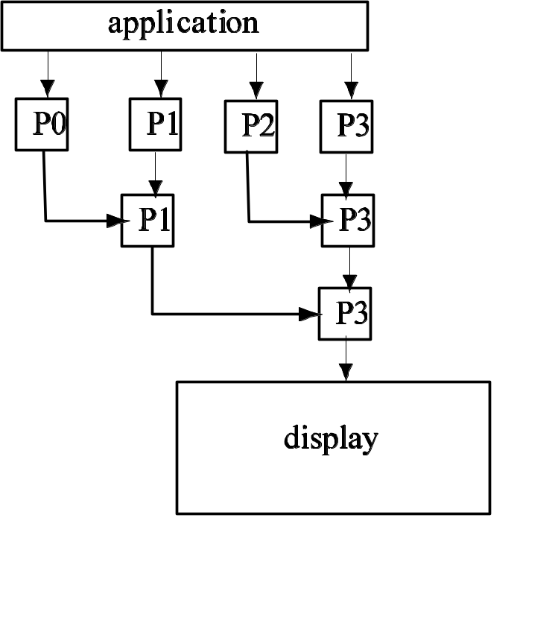
Tree Compositing
Composite in pairs
Send color and depth buffers
Each time half processors become idle
Angel: Interactive Computer Graphics 5E © Addison-Wesley 2009

Slide 18
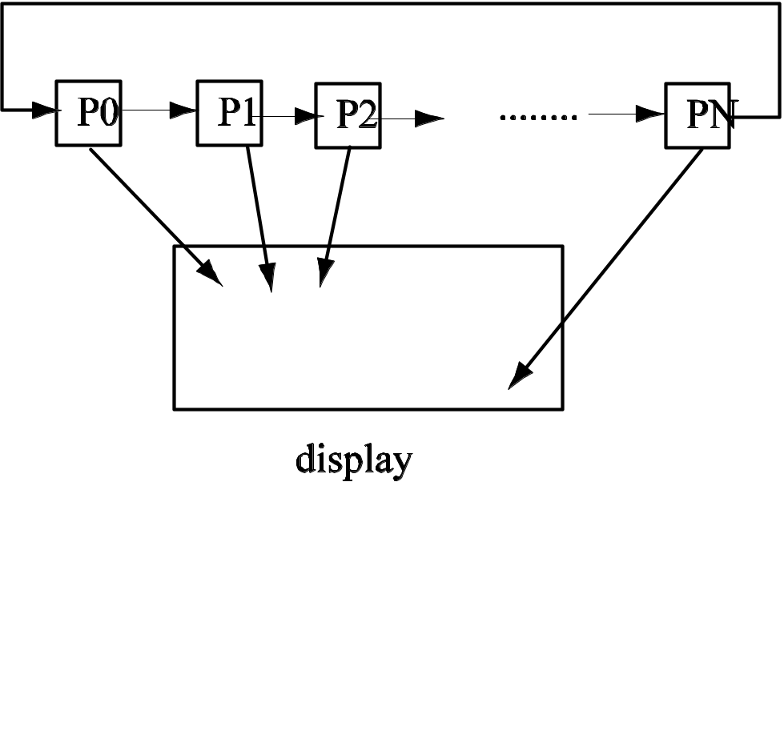
Binary Swap Compositing
Each processor responsible for one part of display
Pass data to right n times
Angel: Interactive Computer Graphics 5E © Addison-Wesley 2009

Slide 19

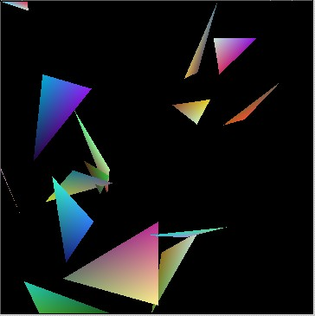
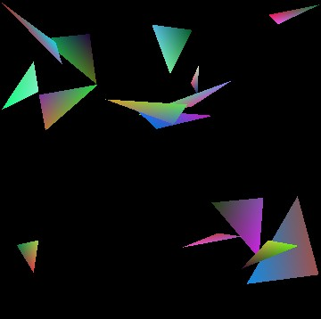
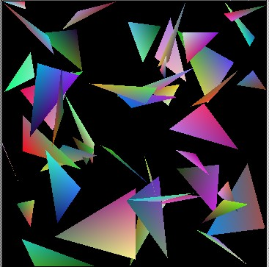
Sort-Last Rendering for a Random Triangles Application
Angel: Interactive Computer Graphics 5E © Addison-Wesley 2009

Slide 20
Comparison
Sort first
  Appealing but hard to implement
Sort middle
  Used in hardware pipelines
  More difficult to implement with add-on commodity cards
Sort last
  Easy to implement with a compositing stage
  High network traffic
Angel: Interactive Computer Graphics 5E © Addison-Wesley 2009

Slide 21
Mapping to Clusters
Different architectures
  Shared vs distributed memory
  Communication overhead
  Parallel vs distributed algorithms
Easy to do sort last
Must evaluate communication cost
Standard visualization strategies are incorrect if transparency used
Angel: Interactive Computer Graphics 5E © Addison-Wesley 2009

Slide 22
Vista Azul
Experimental architecture from IBM donated to AHPCC
Half Intel nodes, half AIX nodes
Only one (PCI) graphics card per four processors
Contained a Scalable Graphics Engine (SGE): high speed-high resolution color buffer that is accessible by all processors
Angel: Interactive Computer Graphics 5E © Addison-Wesley 2009

Slide 23
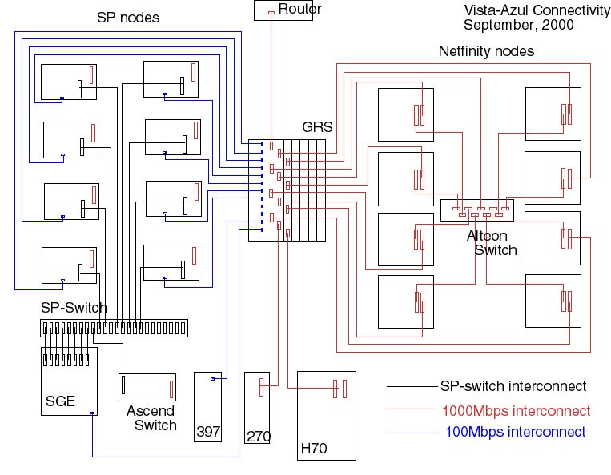
Vista Azul
Angel: Interactive Computer Graphics 5E © Addison-Wesley 2009

Slide 24
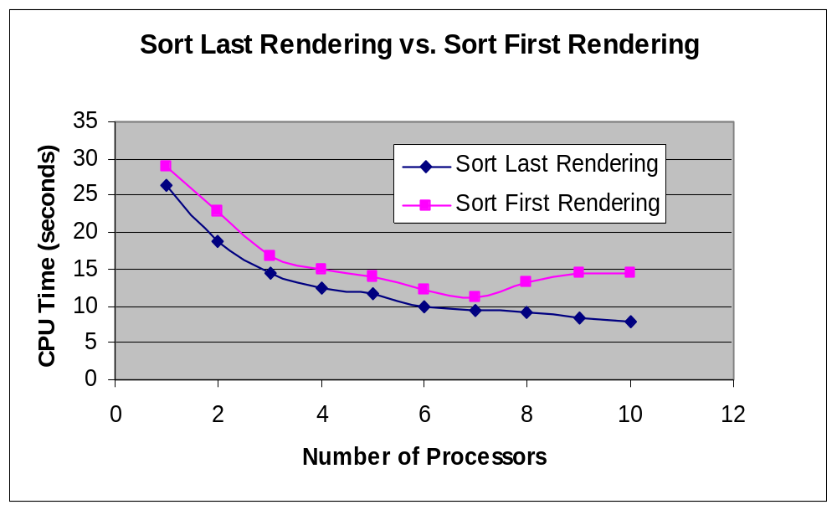
Comparison Between Sort-First and Sort-Last
Angel: Interactive Computer Graphics 5E © Addison-Wesley 2009

Slide 25
Performance on a PC Cluster
Following experiments were done by Ye Cong on the CS cluster
  6 Intellestations
  Gigabit Ethernet
  GForce 3 graphics
Show the effect of network
Angel: Interactive Computer Graphics 5E © Addison-Wesley 2009

Slide 26
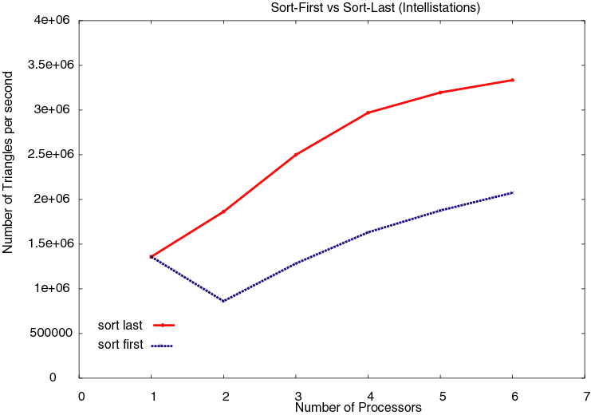
Sort-First vs Sort Last
Random Triangles
Angel: Interactive Computer Graphics 5E © Addison-Wesley 2009

Slide 27
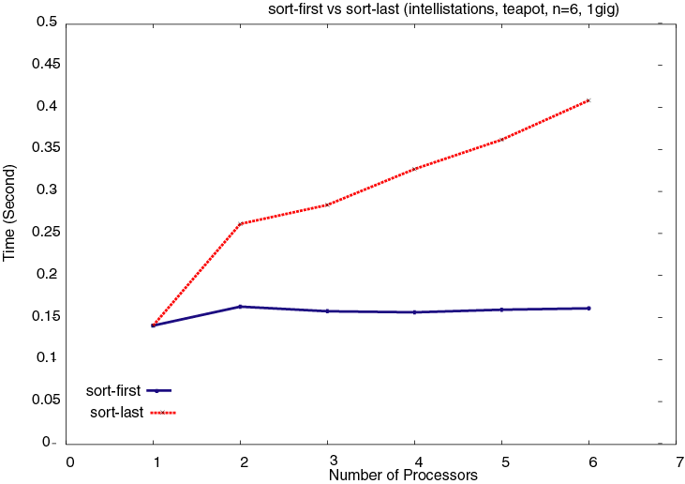
Sort First vs Sort Last
Teapot
Angel: Interactive Computer Graphics 5E © Addison-Wesley 2009

Slide 28
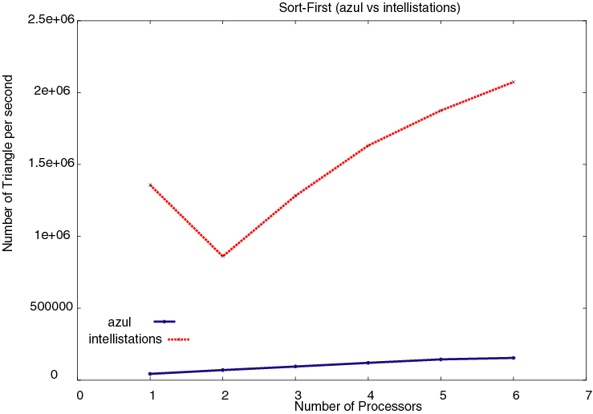
Azul vs Intellistations
Angel: Interactive Computer Graphics 5E © Addison-Wesley 2009

Slide 29
Software for Parallel Rendering
Write your own sort-first sort-last
WireGL/Chromium (Stanford)
Embed inside package (VTK)
Angel: Interactive Computer Graphics 5E © Addison-Wesley 2009

Slide 30
WireGL: A Distributed Graphics System
A software-based parallel rendering system that unifies the rendering power of a collection of cluster nodes
Scalability is achieved by integrating parallel applications into its sort-first parallel renders
Each node in the cluster can be either a rendering client or a rendering server
Clients submit OpenGL commands concurrently to servers, which render the final physical image
Angel: Interactive Computer Graphics 5E © Addison-Wesley 2009

Slide 31
Chromium
Successor toWireGL
Allows both sort first and sort last rendering
Implemented on CS cluster
Most of gain in performance is bacause Chromium and WireGL can group state-changing commands separately from rendering commands
Angel: Interactive Computer Graphics 5E © Addison-Wesley 2009

Slide 32
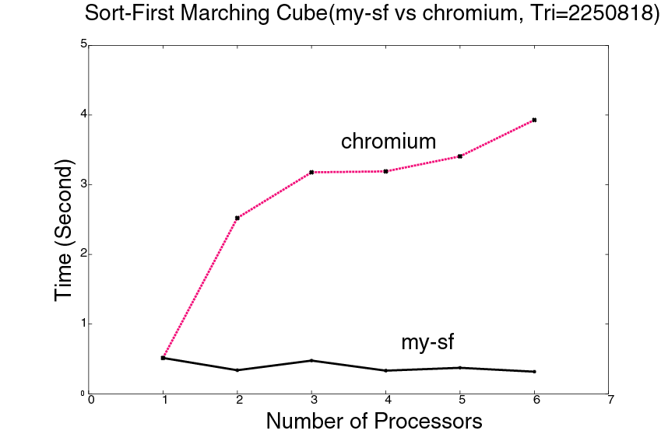
Chromium vs Sort First
MRI rotation
Angel: Interactive Computer Graphics 5E © Addison-Wesley 2009

